Slide 1

Meeting 23-3-2022
Rosa Maessen

Slide 2
Project Proposal
Research Question
Research question:
Can skill mutation result in better performance when doing robot-to-robot learning?
Sub-questions:
How does the skill of a robot mutate during robot-to-robot learning?
Is skill mutation repeatable when using the same conditions?
What enables the mutation of the robots’ skills?

Slide 3
Project Proposal
Research Question
Research question:
Can skill mutation result in better performance when doing robot-to-robot learning?
Can skill mutation result from doing robot-to-robot learning?
Sub-questions:
How does the skill of a robot mutate during robot-to-robot learning?
Is skill mutation repeatable when using the same conditions?
What enables the mutation of the robots’ skills?

Slide 4
Project Proposal
Research Question
Research question:
Can skill mutation result in better performance when doing robot-to-robot learning?
Can skill mutation result from doing robot-to-robot learning?
Can skill mutation result from doing robot-to-robot learning, and if so, how is it enabled?
Sub-questions:
How does the skill of a robot mutate during robot-to-robot learning?
Is skill mutation repeatable when using the same conditions?
What enables the mutation of the robots’ skills?

Slide 5
Project Proposal
Research Question
Research question:
Can skill mutation result in better performance when doing robot-to-robot learning?
Can skill mutation result from doing robot-to-robot learning?
Can skill mutation result from doing robot-to-robot learning, and if so, how is it enabled?
Sub-questions:
How does the skill of a robot mutate during robot-to-robot learning? Does the skill of a robot mutate during robot-to-robot learning?
Is skill mutation repeatable when using the same conditions?
What enables the mutation of the robots’ skills?

Slide 6
Project Proposal
Research Question
Research question:
Can skill mutation result in better performance when doing robot-to-robot learning?
Can skill mutation result from doing robot-to-robot learning?
Can skill mutation result from doing robot-to-robot learning, and if so, how is it enabled?
Sub-questions:
How does the skill of a robot mutate during robot-to-robot learning? Does the skill of a robot mutate during robot-to-robot learning, and if so, how does it mutate?
Is skill mutation repeatable when using the same conditions?
What enables the mutation of the robots’ skills?

Slide 7
Hypothesis 1
How does the skill of a robot mutate during robot-to-robot learning?
During the first skill learning steps, the skill mutation will be obviously visible. This is expected as the demonstrated behavior of the human is assumed to be suboptimal, and multiple steps are needed until the collaborative task mutates to an optimal solution.
If there are no external factors influencing the behavior of the robot, the robot's mutation will eventually converge, however as the experiments are done in the real world, which means lots of variability, this will most probably not happen.

Slide 8
Hypothesis 2
Is skill mutation repeatable when using the same conditions?
If set in the exact same conditions, the skill mutation is repeatable. However, this will most probably not follow out of the experiments as it is nearly impossible to set the exact same conditions.

Slide 9
Hypothesis 3
What enables the mutation of the robots’ skills?
Every aspect, which will be different from the previous trial, will influence the mutation of the robot's skill, as different conditions will result in different behavior.

Slide 10
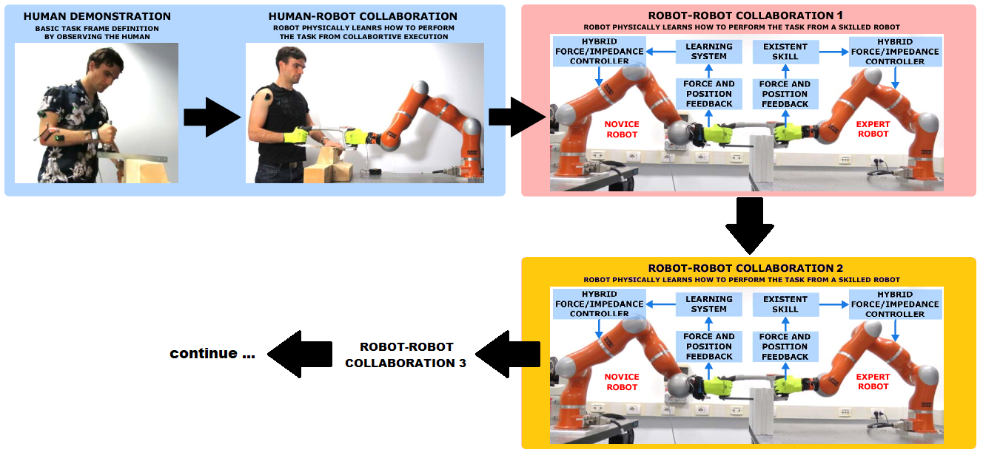
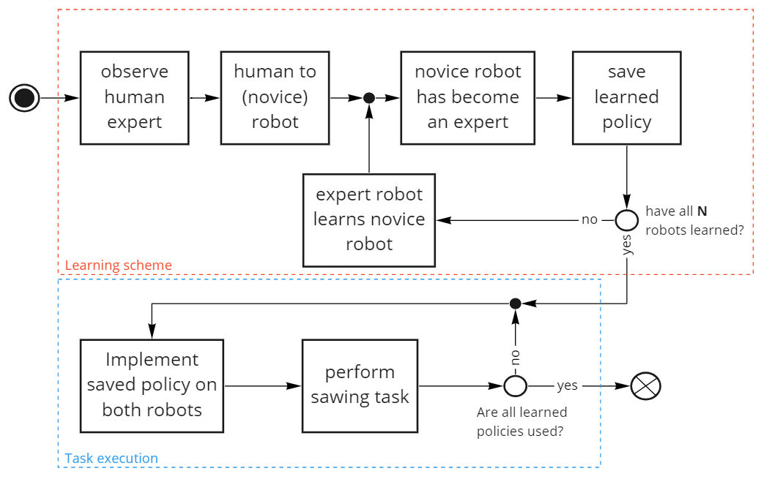
Experiment 1
09-10-2020

Slide 11
Experiment 2
Repeat experiment 1 multiple times, with the exact same conditions:
Human Demonstration
Starting position
Same parameters

Slide 12
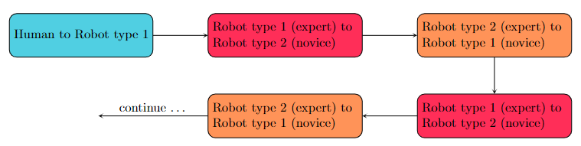
Experiment 3
Multiple conditions
Types of robot
Material
Frequency of sawing
Different demonstrations (e.g. multiple persons)
Different learning times
Learning types

Slide 13
Python
Keep frequency constant
Different some parameters

Slide 14
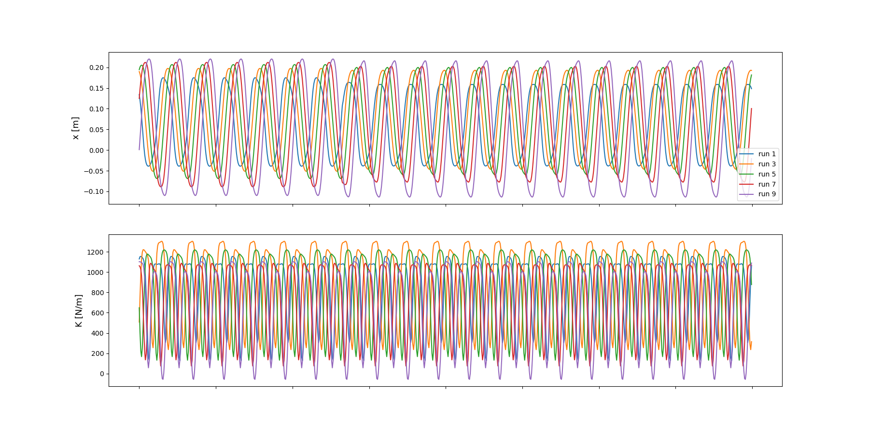
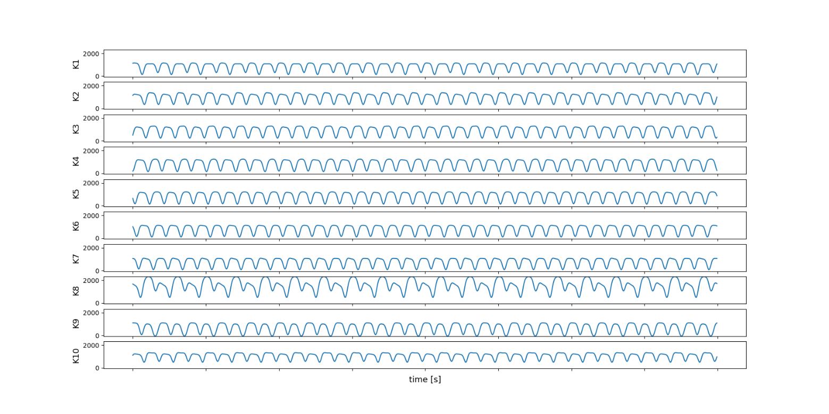
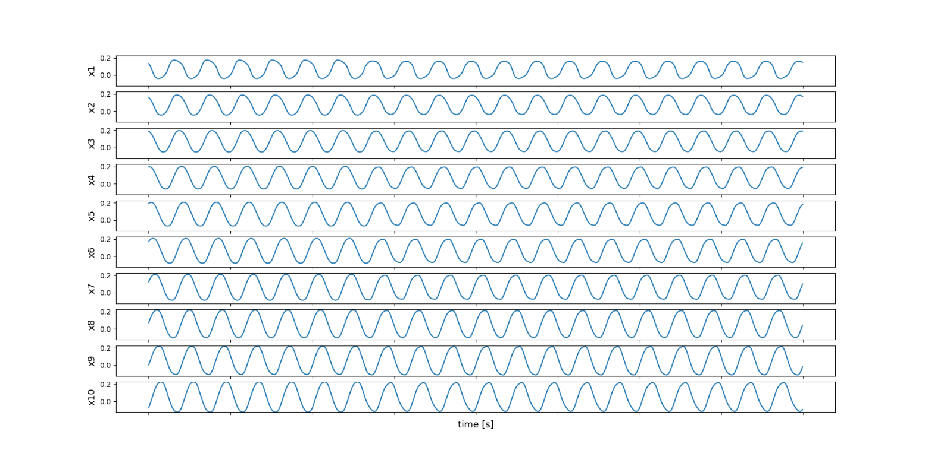
Using Frequency Works!
But: Phase Shift

Slide 15
Using Frequency Works!
But: Phase Shift

Slide 16
Phase Shift When Repeating the Signal

Slide 17
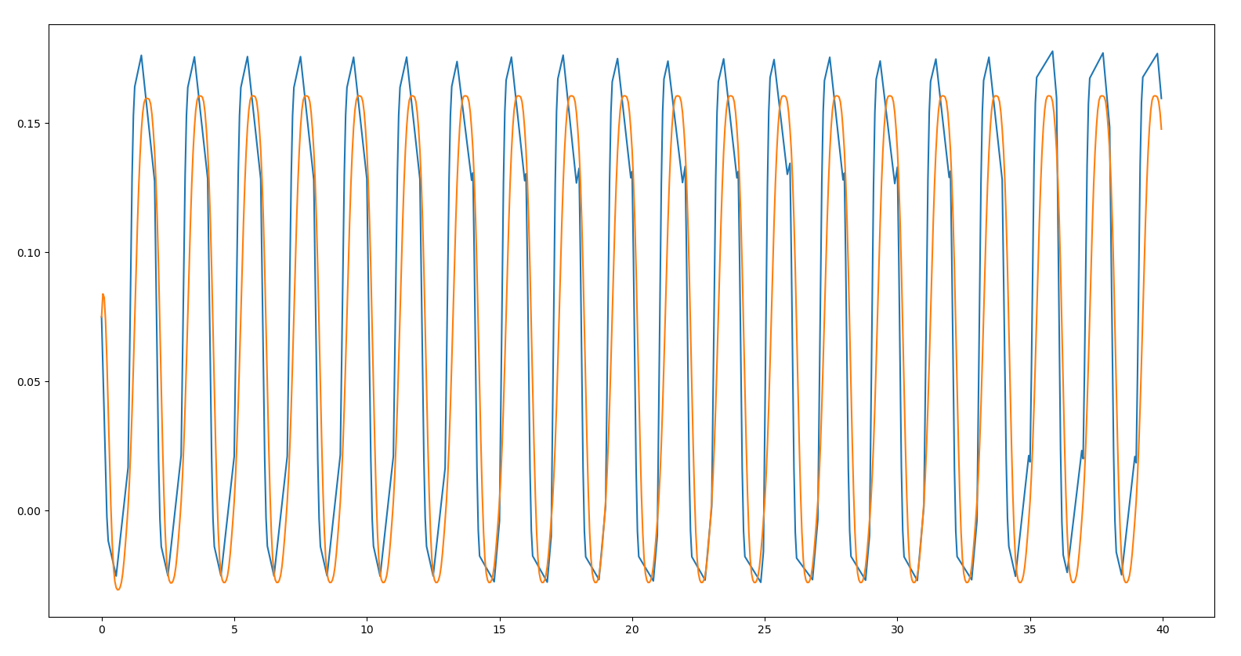
Phase Shift When Repeating the Signal

Slide 18
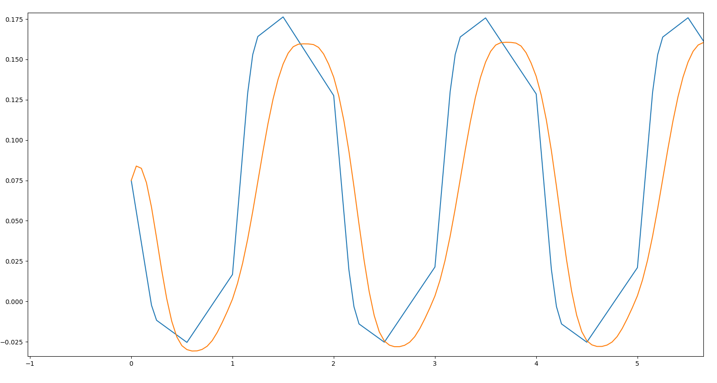
Phase Shift When Repeating the Signal

Slide 19
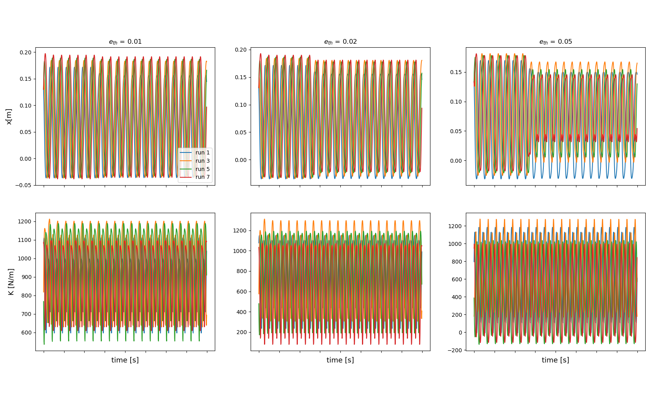
Effect of changing eth

Slide 20
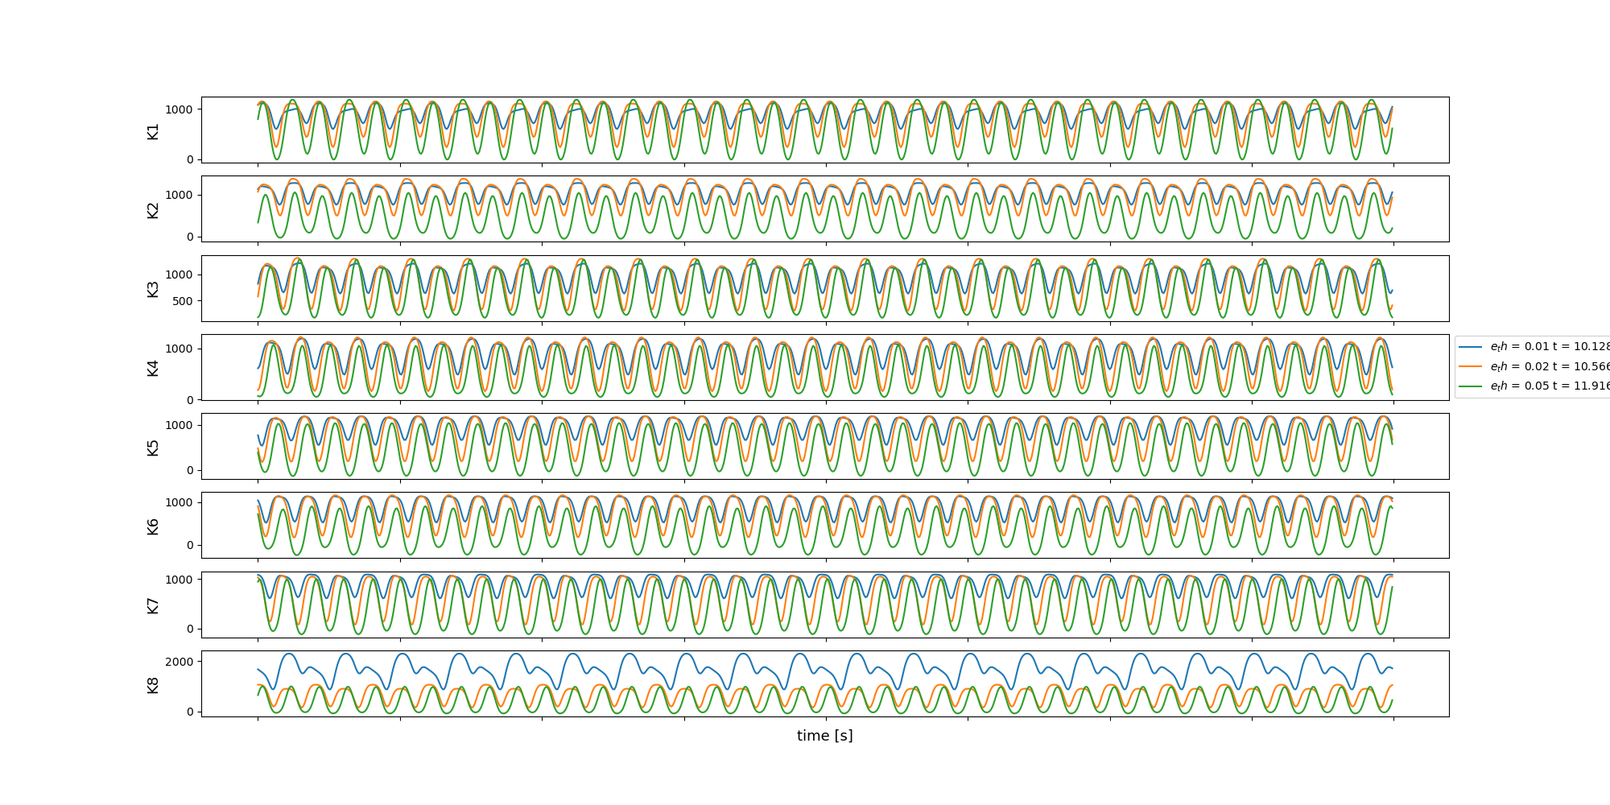
Effect of changing eth

Slide 21
Effect of changing eth

Slide 22
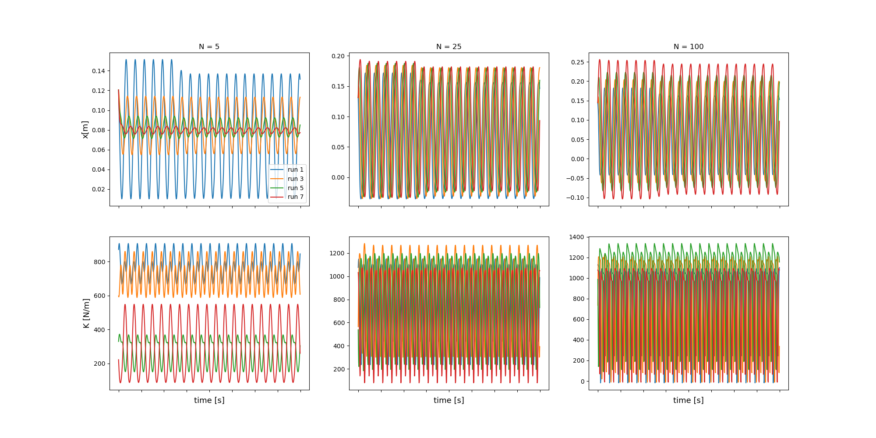
Effect of Changing N (eth = 0.02)

Slide 23
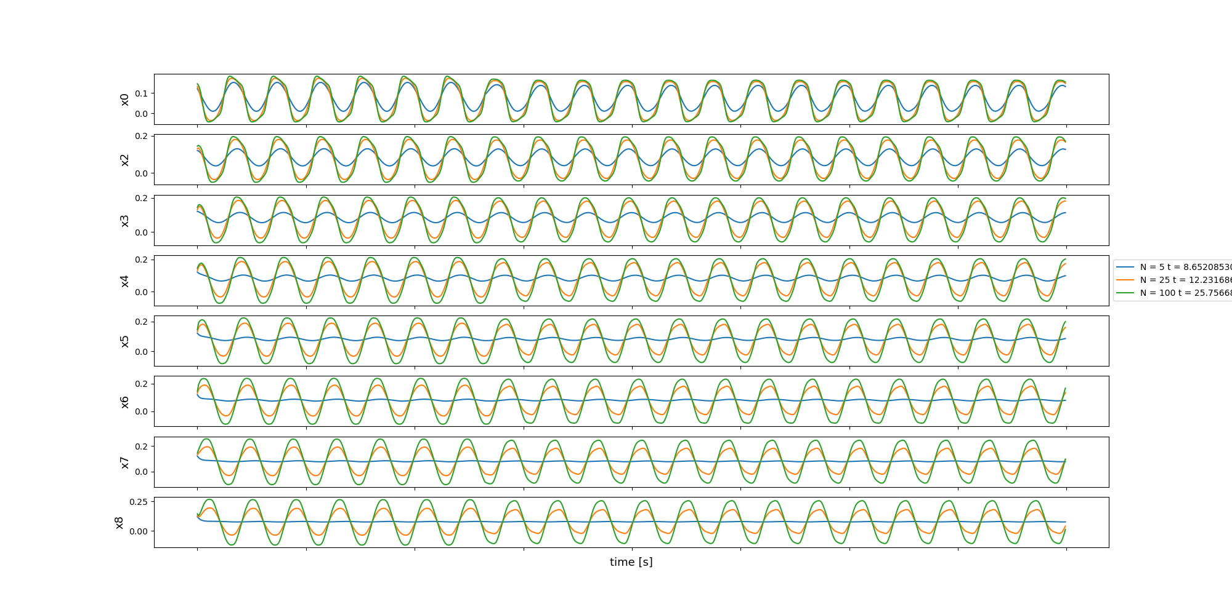
Effect of Changing N (eth = 0.02)

Slide 24
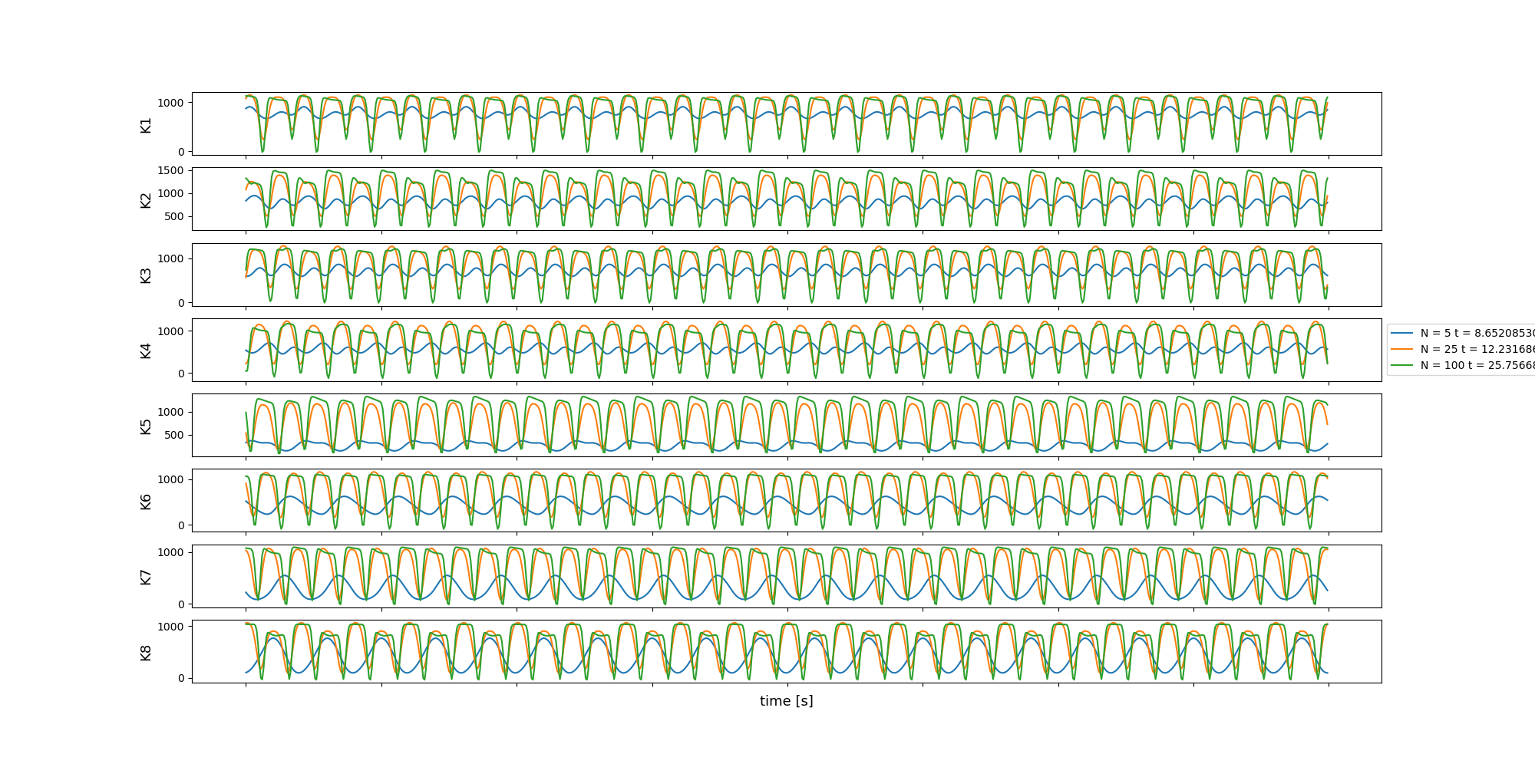
Effect of Changing N (eth = 0.02)

Slide 25
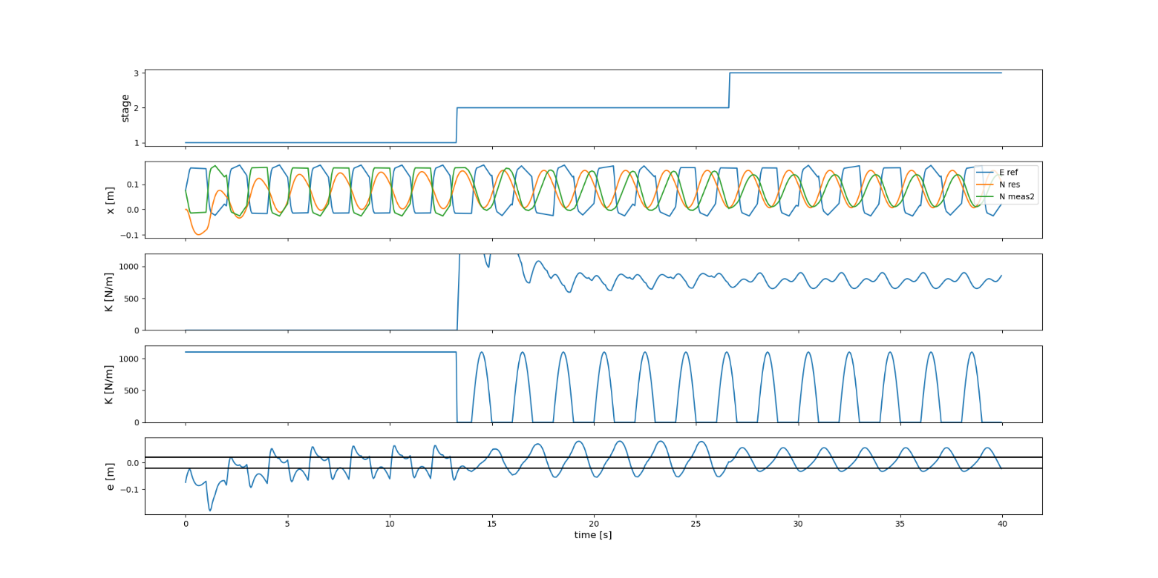
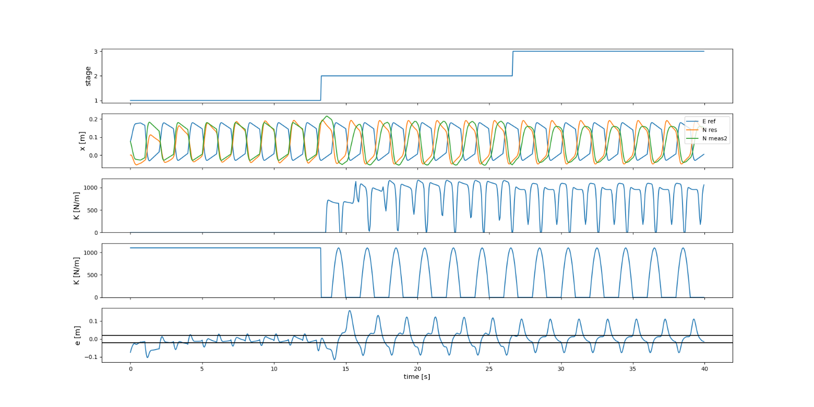
Effect of Changing N

Slide 26
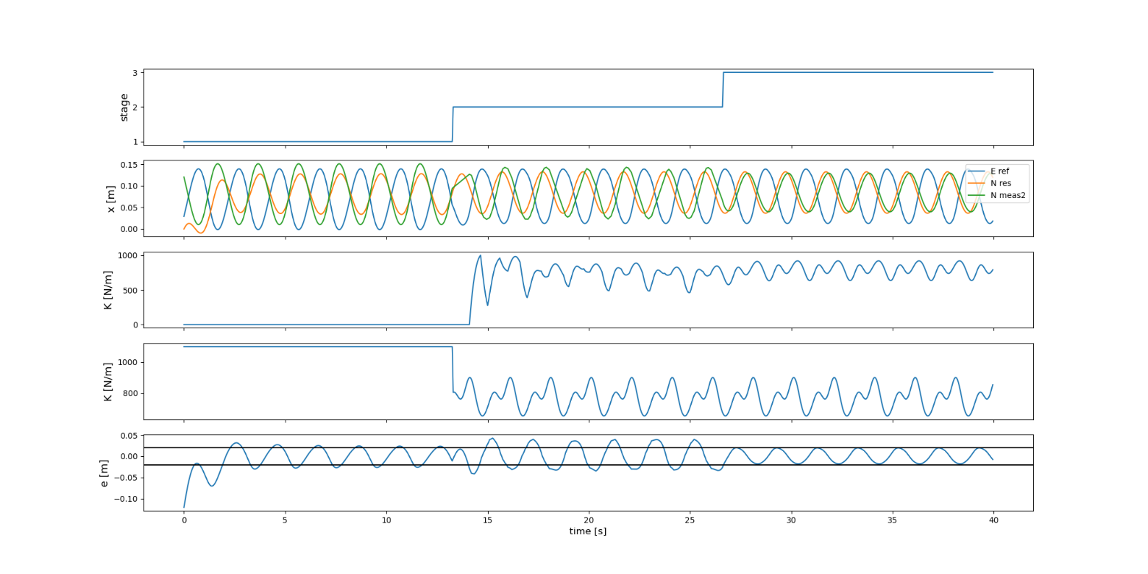
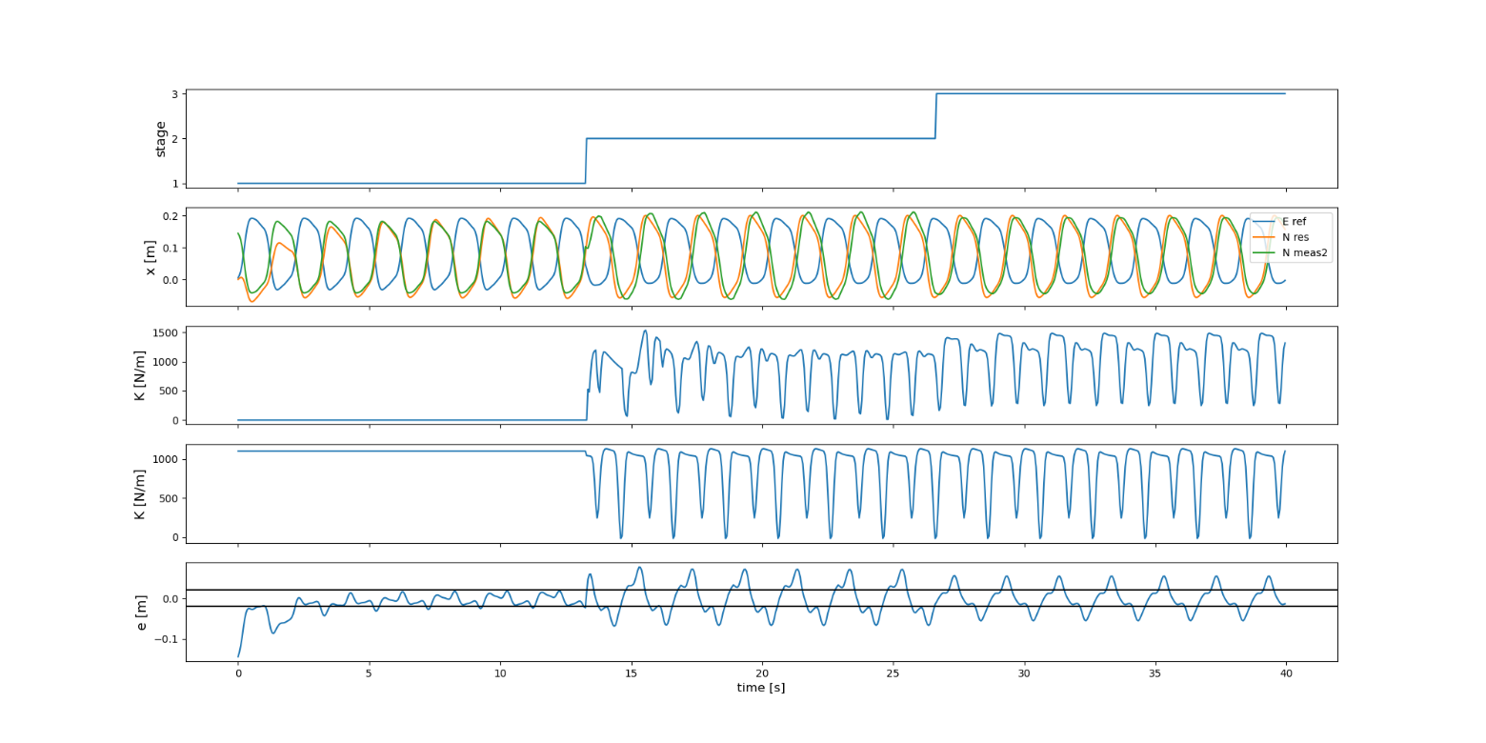

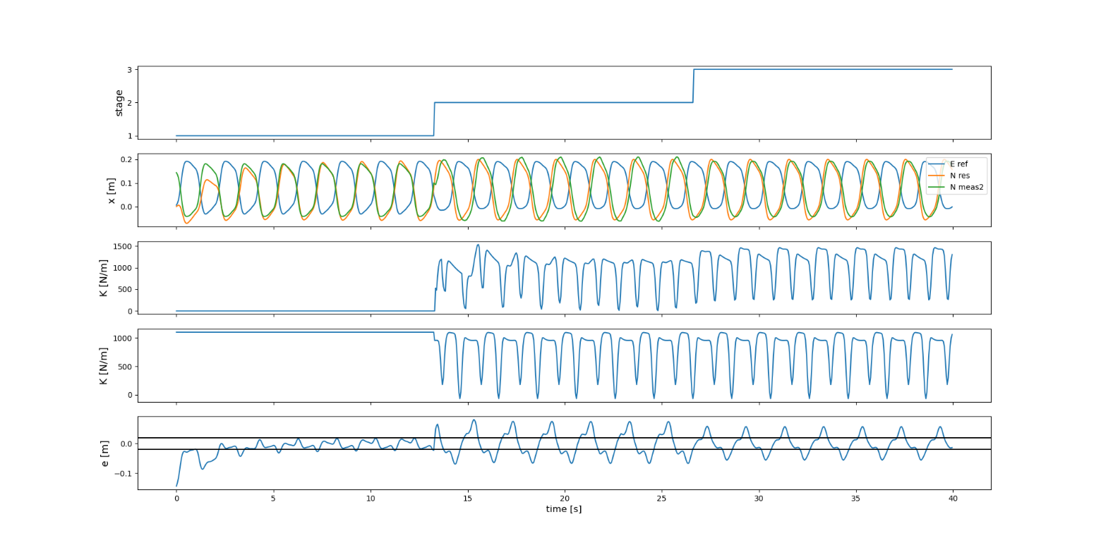
Effect of Changing N

Slide 27
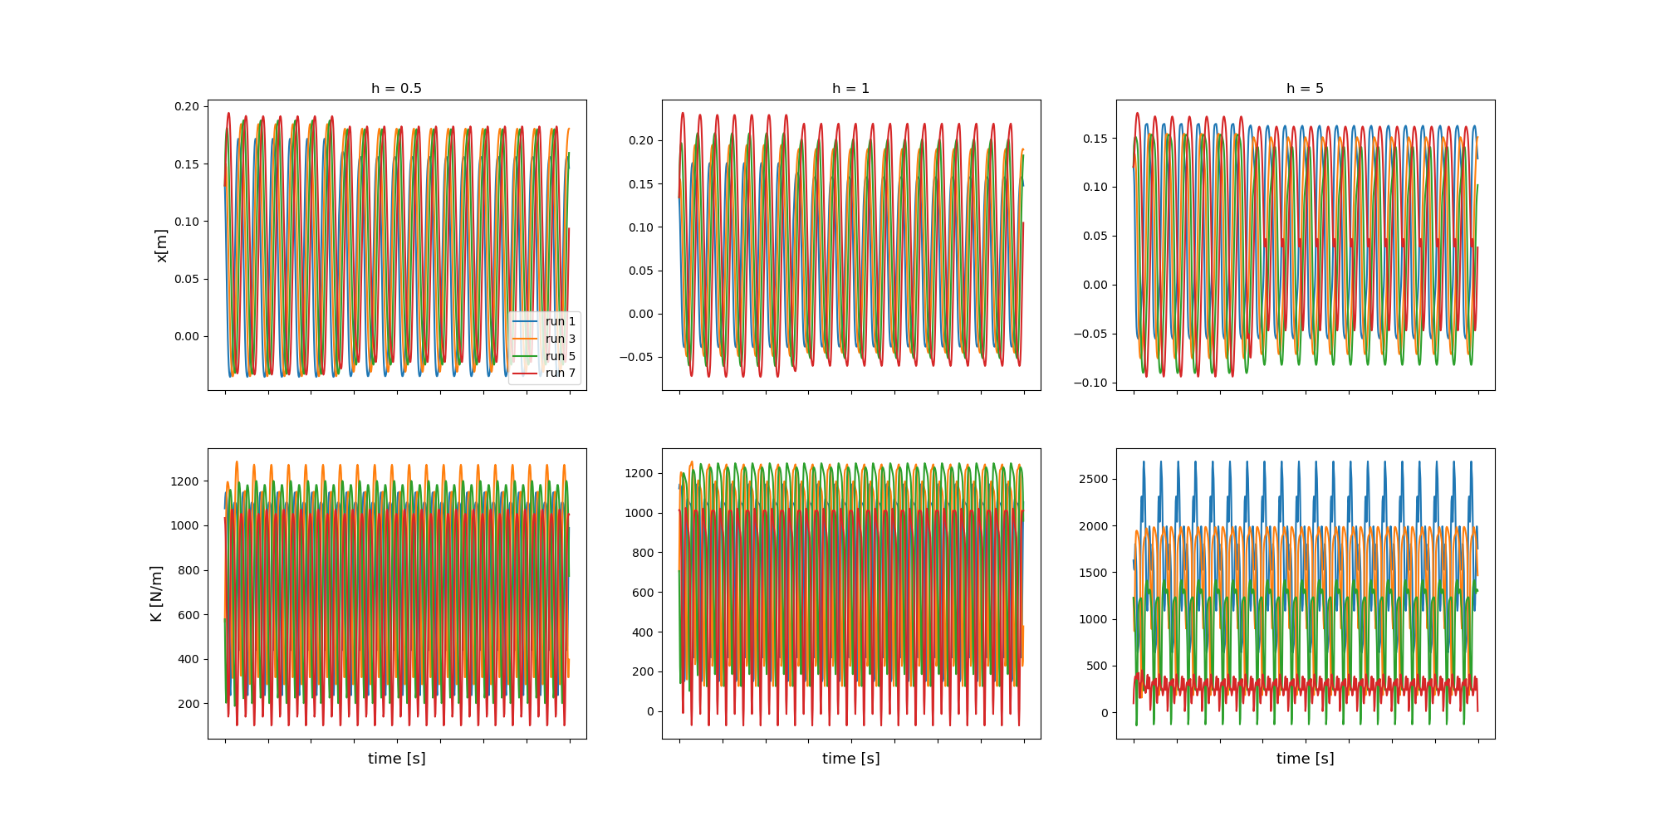
Effect of changing h

Slide 28
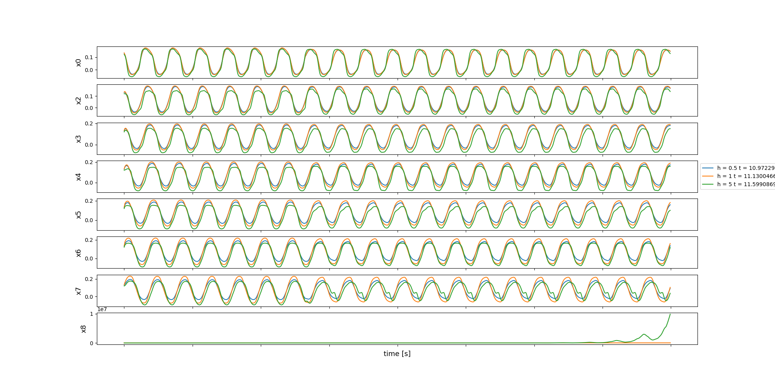
Effect of changing h

Slide 29
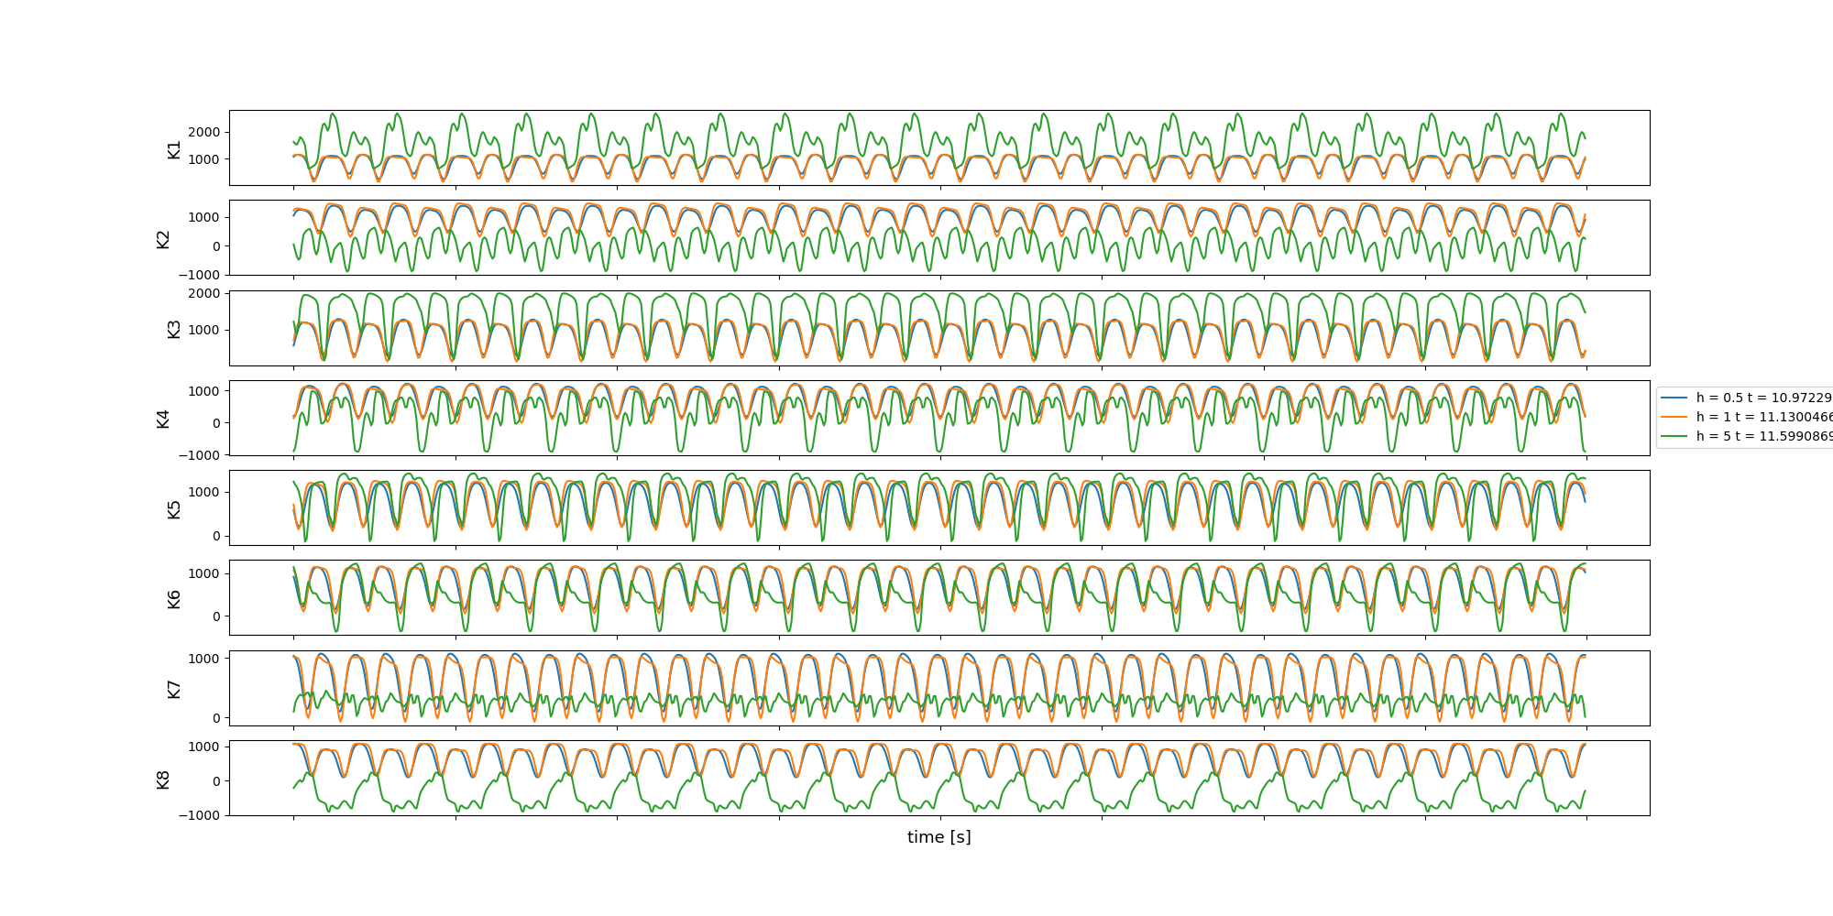
Effect of changing h

Slide 30
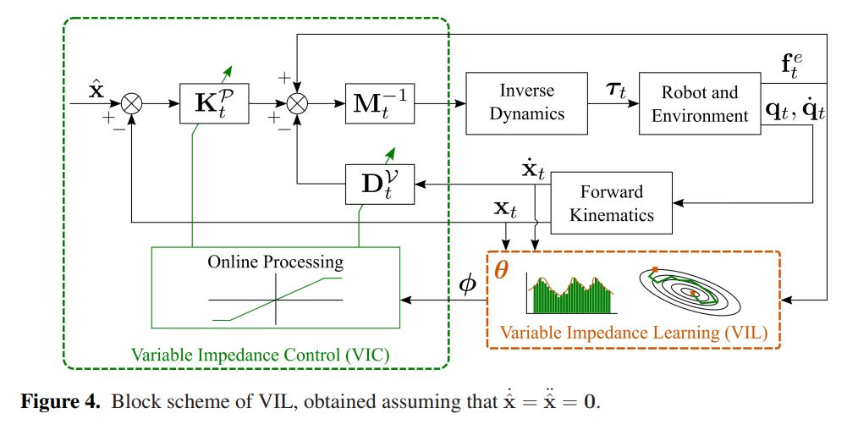
Variable impedance control
Abu-Dakka, F. J., & Saveriano, M. (2020). Variable impedance control and learning—a review. Frontiers in Robotics and AI, 177.

